Slide 1

FLUTTER APP PROJECT
DEVELOPED BY :
OUALI Yahya
y.ouali@etu.enset-media.ac.ma
SUPERVISED BY :
Mr Youssfi Mohamed

Slide 2
Objectif Of Project :
Our Main Objectif Is Creating simple flutter app with counter and git users,refresh, also about us page

Slide 3
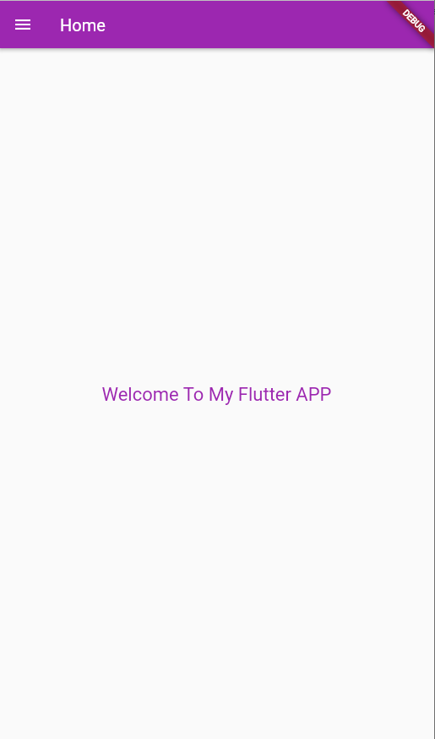
Main Page :

Slide 4
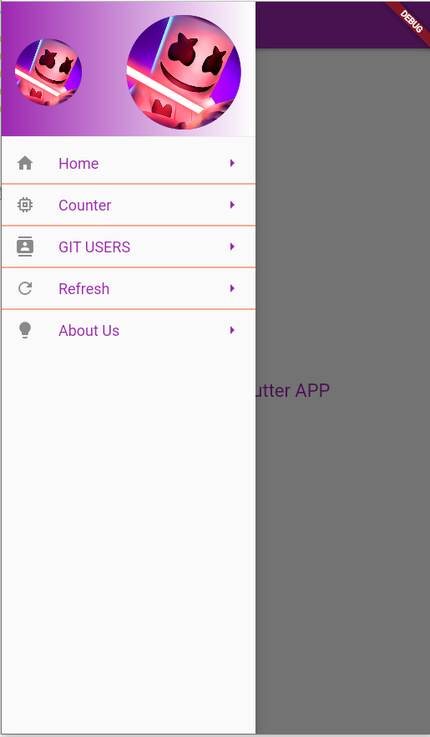
Menus :

Slide 5
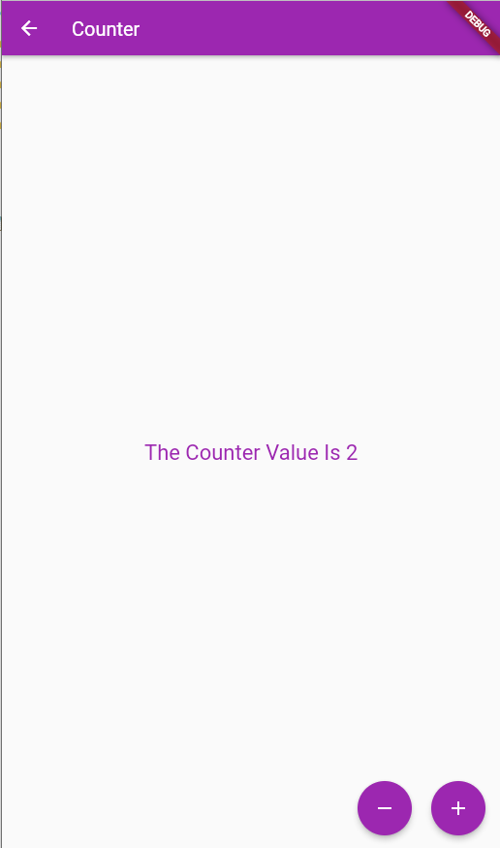
Counter Page :

Slide 6
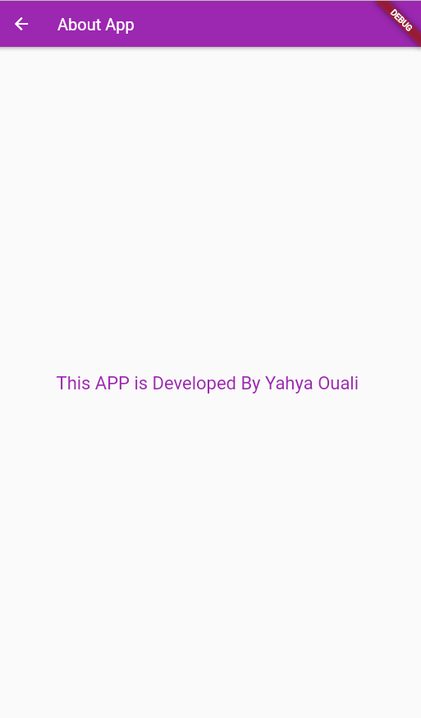
About Us Page :

Slide 7
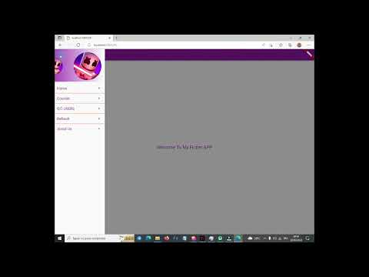
Preview Video :

Slide 8
Thank You :)

